Slide 1
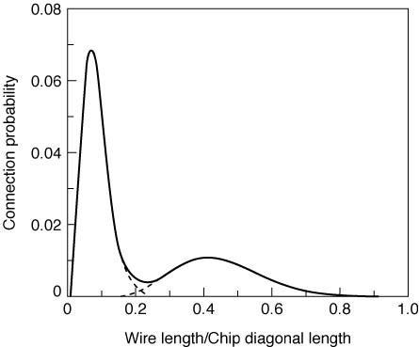
Nature of Interconnect
Local Interconnect
Global Interconnect
Notes:
if Ld is the die diagonal ~ sqrt (Ad) where Ad is the chip area
average length of global wires is Lav ~ sqrt (Ad)/3

Slide 2
Global Interconnect
System level signal interconnect - buses
Vdd and Gnd planes
System clock
Notes:
System buses are essential in most digital systems - a bundle of wires that connect a set of senders and receivers; when one device is sending, all others should be disconnected (or listening) - usually done with tristate devices

Slide 3
Impact of Interconnect Parasitics
Reduced reliability
Reduced performance
Classes of parasitics
capacitive
resistive
inductive

Slide 4
System Level Signal Interconnect
Many drivers - only one active at a time
Many receivers - many may be active at a time
W_{out}
X_{out}
Y_{out}
Z_{out}
Bus
receivers
Bus
Tristate
Bus
drivers
A_{in}
B_{in}
C_{in}
D_{in}
Notes:
Only one bus transmitter (driver) at a time; many receivers possible
buses impact both speed and power performance - have both high switching activities and large capacitive loads (15% of the total power in the Alpha 21064 and 30% of the total power in the Intel 80386)

Slide 5
Tristate Buffers
Three states - 0, 1, and z (high impedance)
In
Out
En
0
1
!En
!In
1
0
In
Out
En
z (disconnected)

Slide 6
Reducing Effective Capacitance
W_{out}
X_{out}
W_{out}
X_{out}
Y_{out}
Z_{out}
A_{in}
B_{in}
Y_{out}
Z_{out}
A_{in}
B_{in}
C_{in}
D_{in}
C_{in}
D_{in}
Shared resources may also incur extra switching activity
Notes:
Split large capacitive load into two parts if the architecture allows

Slide 7
Driving Large Capacitances
In
Out
C_{L} V_{swing/2}
t_{pHL} = -------------
I_{av}
C_{L}
Increase with transistor sizing
I_{D} = k’/2 W/L (…)
Notes:
reduce CL
Increase Iav by increasing size of driving transistors (big W, minimum L) - will effect performance of gate driving this one
Lower Vswing - but leaves us with smaller noise margins and then would need sense amps at receivers to restore signals (this overhead is only justifiable for large fan-in nodes (e.g., buses and data lines in memory arrays))

Slide 8
Single Inverter as buffer
A
U*A
In
Cin
CL = x. Cin
1
u
Total propogation delay = tp(inv) + tp(buffer)
tp0 - delay of minimum sized inverter with single minimum sized inverter for fanout
tp = u. tp0 + x/u tp0
uopt = sqrt(x); tp,opt = 2 tp0. Sqrt(x)

Slide 9
Use Cascaded Buffers
in
u^{N-1}
out
1
u
u²
C_{in}
C₁
C₂
C_{L}
C_{L} = xC_{in} = u^{N} C_{in}
u_{opt} = e
Notes:
For class handout

Slide 10
Use Cascaded Buffers
in
u^{N-1}
out
1
u
u²
C_{in}
C₁
C₂
C_{L}
3 9 27 81
1 3 9 27
C_{L} = xC_{in} = u^{N} C_{in}
u_{opt} = e
Notes:
For lecture
Gradually scale up the stages by dividing the delay over N stages. The value of u that optimizes the propagation delay have seen is e (2.7182 …).
Are assuming we have x times larger CL on buffer output. Inserting buffers only makes sense when x >4 (CL ~ fan-out of 4 similar gates).

Slide 11
t_{p} as a Function of u and x
Notes:
Notice that the curve is relatively flat (and minimum) around e, so somewhere between 2 and 4 are acceptable.
Large u reduces the number of buffer stages - but makes each transistor biggggg. How does one go about building a W=81 transistor?

Slide 12
Impact of Cascading Buffers
x | Unbuffered | Single Buffer | Cascaded Buffers
10 | 10 | 6.3 | 6.3
100 | 100 | 20 | 12.5
1,000 | 1,000 | 63 | 18.8
10,000 | 10,000 | 200 | 25
chip bus
I/O pads
t_{opt} /t_{p0} versus x for various driver configurations
C_{in} = 10 fF in 1 micron CMOS
Notes:
x = 1000 is typical of off chip capacitances
Another worry with buses …

Slide 13
Designing Large Transistors
D(rain)
S
D
G
D
S
S(ource)
G(ate)
Circular transistors
Small transistors in parallel
Notes:
Many small transistors in parallel - reduces the resistance of the gate with shorter sections of poly and low resistance metal by pass

Slide 14
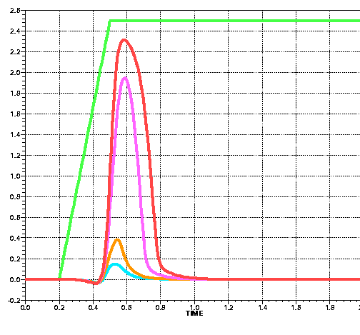
Capacitive Coupling (Crosstalk)
Signal wire glitches as large as 80% of the supply voltage will be common due to crosstalk between neighboring wires as feature sizes continue to scale
Crosstalk vs. Technology
Pulsed Signal
0.12m CMOS
0.16m CMOS
Black line quiet
Red lines pulsed
0.25m CMOS
Glitches strength vs technology
0.35m CMOS
From Dunlop, Lucent, 2000
Notes:
Occurs when two signal wires run along side one another for long distances

Slide 15
Battling Capacitive Crosstalk
Avoid parallel lines
Use shielding
shielding
wire
signal
wire
GND
V_{dd}
shielding layer
GND
substrate (GND)

Slide 16
Inductive Effects
When wires are sufficiently long or circuits are sufficiently fast, inductance of the wire starts to dominate the delay behavior
Must consider wire transmission line effects
Wave mode instead of diffusion equations used so far
Signal alternately transfers energy from capacitive to inductive modes
Notes:
In transmission line - signal propagates as a wave (in the RC model we assume the signal diffuses from the source to destination). In a signal wave the signal propagates by transferring energy from capacitive to inductive nodes.
Effects speed and ringing – when wave is reflected back on itself. To avoid wave reflection of signal must terminate wire correctly (a matched termination, avoid open and short circuit terminations)

Slide 17
Transmission Line Considerations
Transmission line effects should be considered when the rise or fall time of the input signal is smaller than the time-of-flight of the transmission line
Rule of Thumb
t_{r} (t_{f}) < 2.5 t_{flight} = 2.5 L/v
Notes:
V is the velocity (speed)

Slide 18
Power and Ground Distribution
Notes:
Try to reduce maximum wire length while avoiding multiple crossovers of Vdd and GND
Want to maximize contact perimeter since the current tends to concentrate around the perimeter.

Slide 19
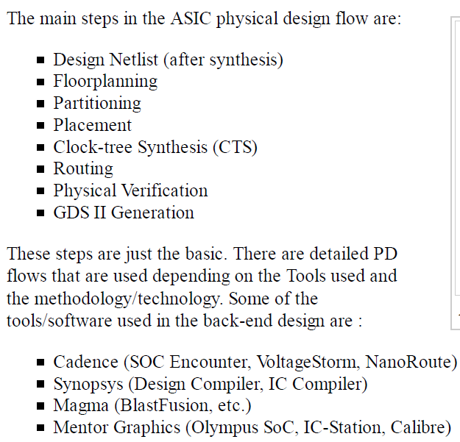

Slide 20
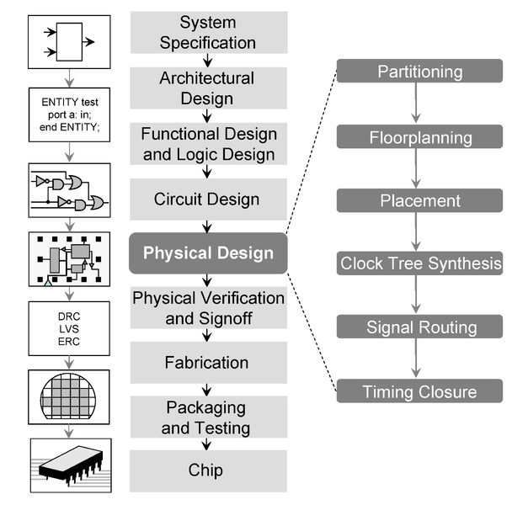

Slide 21
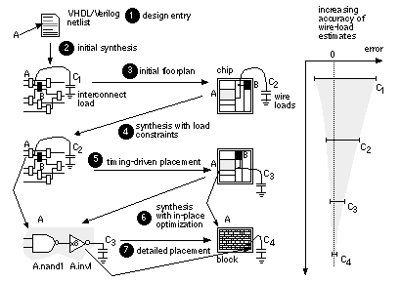

Slide 22
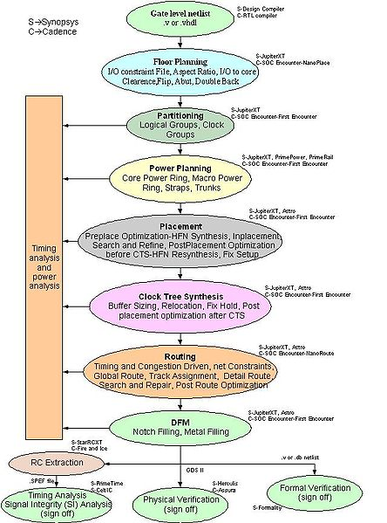

Slide 23
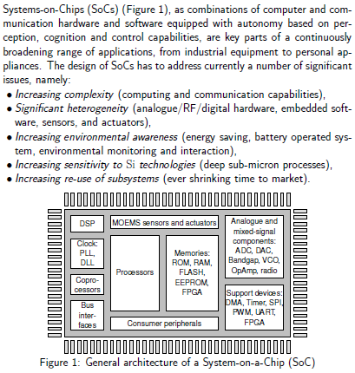

Slide 24
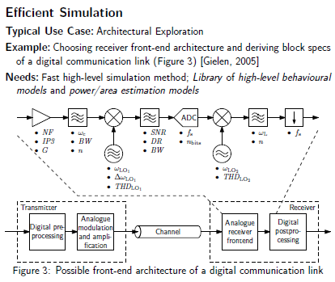

Slide 25
